Slide 1


Presentation

Slide 2


Today's agenda
Project recap
Problem
The Analytics team
Process
Insights
Summary

Slide 3

An audit of their big data practice
Recommendations for a successful IPO
An analysis of their content categories that highlights the top 5 categories with the largest aggregate popularity
Project Recap

Slide 4


Problem : Findind the Top 5 categories with the largest aggregate popularity

Slide 5
Process
1
Data Understanding
Data Cleaning
2
Data Modeling
3
4
Data Analysis
5
Uncover insights

Slide 6
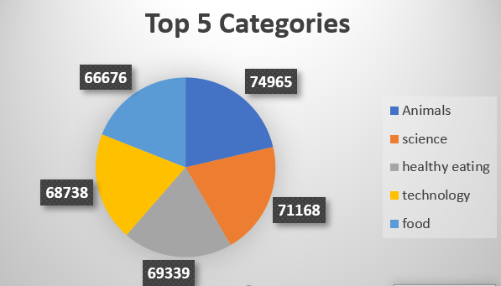

Insights

Slide 7

Thank you!
ANY QUESTIONS?

